Slide 1


Steve's Car Showroom
MySQL Case Study – Analysis
Power BI Dashboard
Abhinav Reddy - Data Analyst

Slide 2
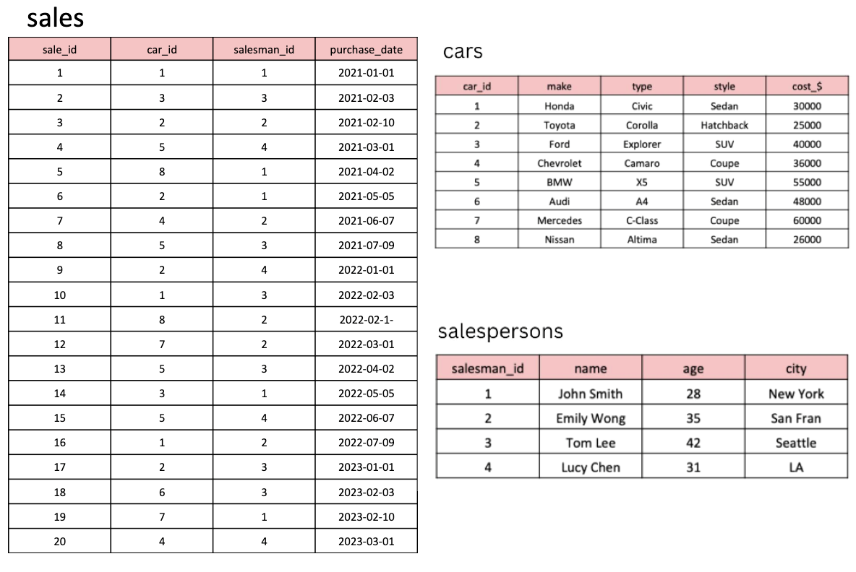
Problem Statement: Analyzing the Steve’s top-end car showroom and providing him crucial insights and answers he requires

Slide 3
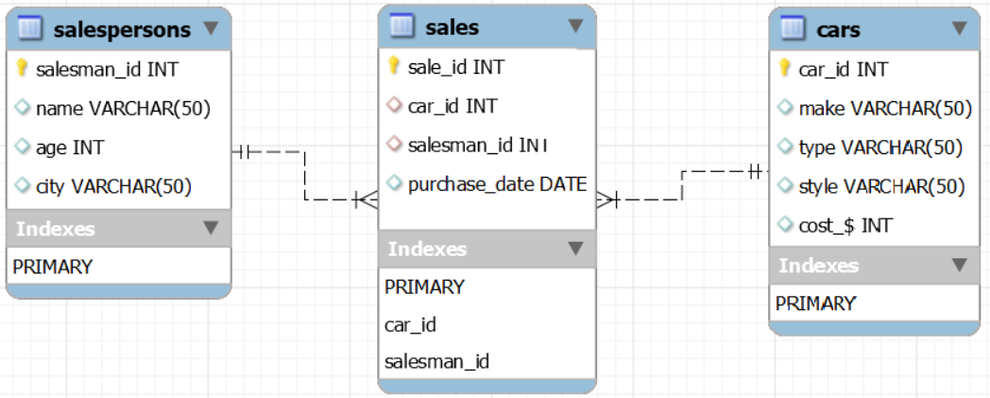
Entity Relationship Diagram (ERD)
We can observe salespersons & sales has one-to-many relationship and also cars & sales has one-to-many relationship.

Slide 4
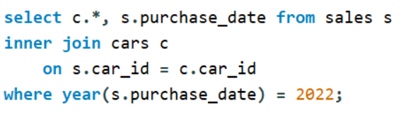
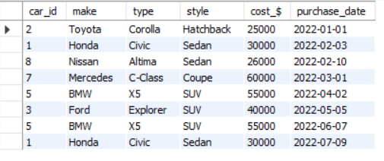
INSIGHTS & OBSERVATIONS
As per Steve’s request we queried the details of all cars purchased in the year 2022 and we can observe 8 records which was purchased in the year 2022.

Slide 5
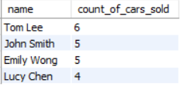
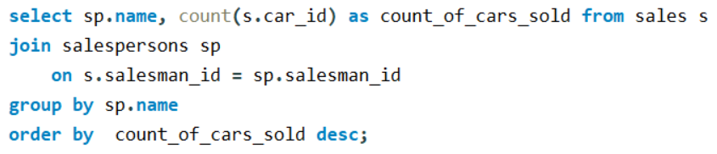
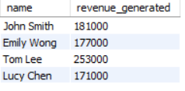
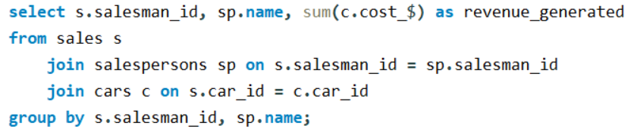
INSIGHTS & OBSERVATIONS
Cars sold by each Salesperson:
The more of number of cars were sold by “Tom Lee” & less number of cars were sold by “Lucy Chen”.
Revenue Generated by each Salesperson:
The highest revenue is generated by “Tom Lee” which is 2,53,000, revenue generated by “Emily Wong” & “John Smith” is approximately same and “Lucy Chen” has generated lowest revenue.

Slide 6
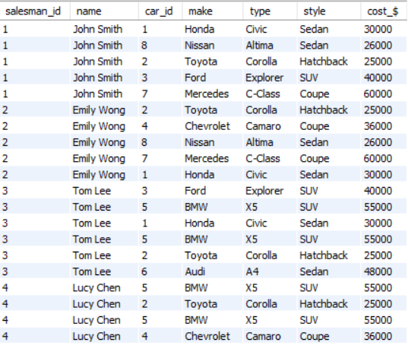
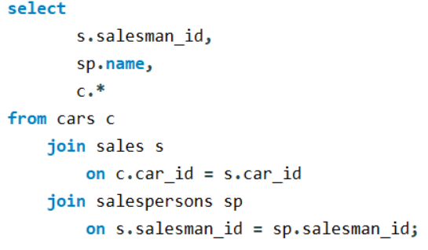
INSIGHTS & OBSERVATIONS
Details of the cars sold by each salesperson:
Salesman 4 has sold more number of cars when compared to other salespersons

Slide 7
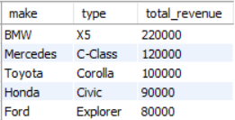
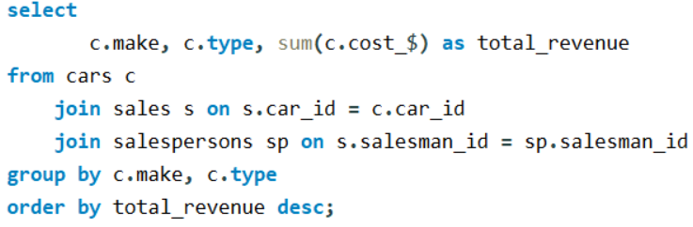
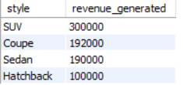
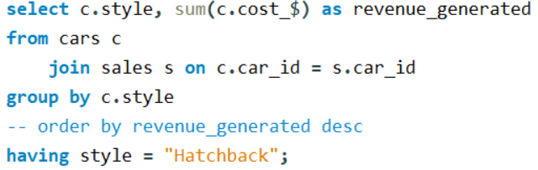
INSIGHTS & OBSERVATIONS
Top 5 cars which generated more revenue :
BMW X5 generated highest revenue followed by Mercedes C-Class.
Revenue by cars style :
SUV cars generated more revenue whereas Hatchback type generated low revenue.

Slide 8
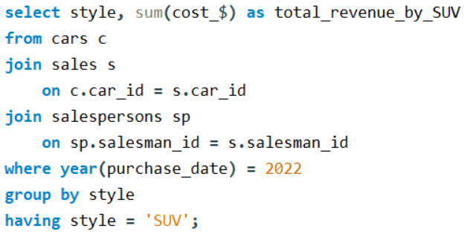

INSIGHTS & OBSERVATIONS
Total revenue generated by the sales of SUV cars in the year 2022:
The total revenue generated by SUV cars is 1,50,000.

Slide 9
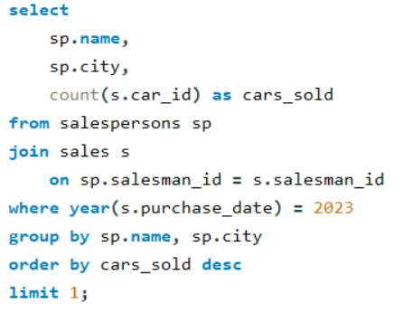

INSIGHTS & OBSERVATIONS
Name and City of the salesperson who sold the most number of cars in the year 2023:
Tom Lee who is from Seattle sold more number of cars in the year 2023.

Slide 10
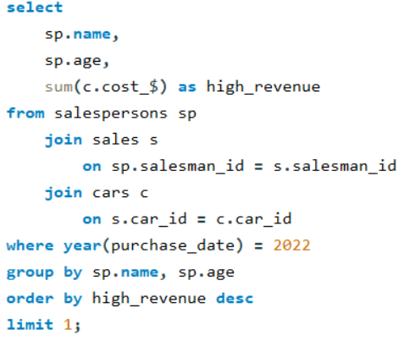

INSIGHTS & OBSERVATIONS
Name and Age of the salesperson who generated the highest revenue in the year 2022:
Emily Wong generated highest revenue in the year 2022.

Slide 11
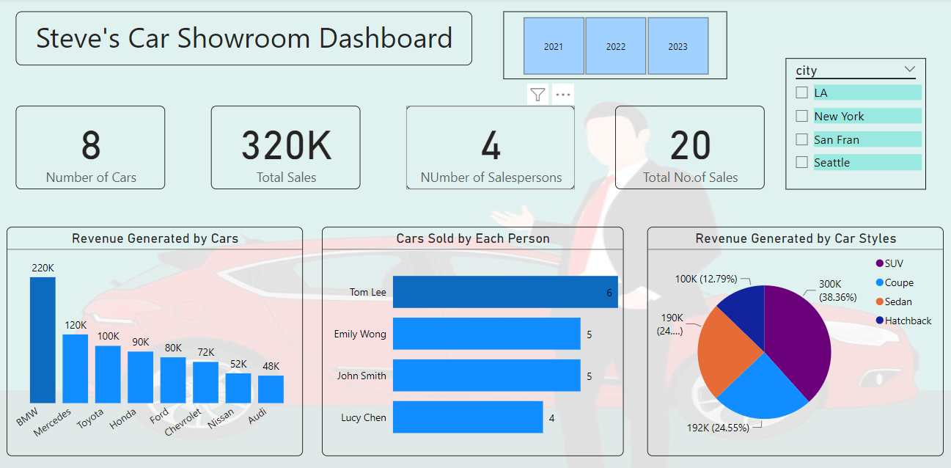

Slide 12
Thank you

